Slide 1

National Institute of Technology Karnataka Surathkal Department of Information Technology
IT 252 DATABASE SYSTEMS
Basics of Functional Dependencies and Normalization for Relational Databases
Dr. Jayashree T R

Slide 2
Course Outline
Course Plan: Theory:
Part A: Parallel Computer Architectures
Week 1: Introduction to to the course, highlighting the data and databases, and related basic concepts. Advantages and need for a database system.
Week 2: Attributes, tuples, relational schema, conceptual model, introduction to SQL-DML, DDL, creating relations/ tables, access and manipulate data.
Week 3,4: Data model, relational model, and SQL, relational data model and relational database constraints, SQL data definition and data types, specifying constraints, basic retrieval queries, complex quires, triggers, views, schema modification.
Week 5-6: ER model development, entity types/sets, attribute, relationship types/sets, simple employee database conceptual design using ER concepts, ER to relational mapping algorithm, EER model.

Slide 3
Course Outline
Functional dependency definition, need of normalization, anomalies and redundant information in tuples, normalization steps (INF, 2NF, 3NF), BCNF, introduction to the higher normal forms.
W
eek 7,8 :
Week 9: Procedural query languages: relational algebra and SQL-SELECT, PROJECT, RENAME, binary and JOIN operations with examples.
Non-Procedural query languages: relational calculus, and SQL-tuple relational calculus, existential a universal quantifier with examples.
Week 10,11 : Transaction management, schedule and serializability, concurrency control,2-phase lock, recovery mechanism: undo/redo values.
Week 12,13: Disk storage- basic file structures, ordered/unordered. binary search, hashing, indexing, importance of indexes, primary and secondary indexing methods, clustered, B tree, B++ trees.
Week 14: Current trends in database system, introduction to data warehousing, data mining.
Practical: MySQL commands
Project: Team of 2 or 3 members

Slide 4
1. Informal Design Guidelines for Relational Databases
Relational database design ultimately produces a set of relations. The implicit goals of the design activity are information preservation and minimum redundancy.
Information preservation in terms of maintaining all concepts, including attribute types, entity types, and relationship types as well as generalization/specialization relationships, which are described using a model such as the EER model.
Minimizing redundancy implies minimizing redundant storage of the same information and reducing the need for multiple updates to maintain consistency across multiple copies of the same information in response to real-world events that require making an update.

Slide 5
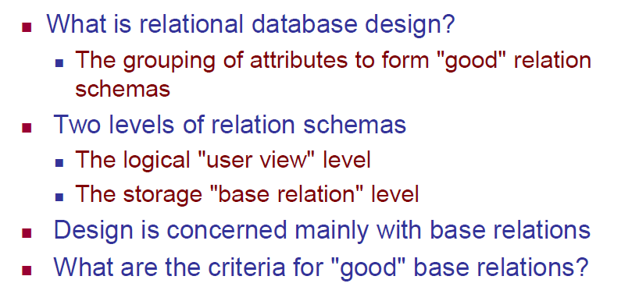
1. Informal Design Guidelines for Relational Databases

Slide 6
1. Informal Design Guidelines for Relational Databases
Four informal guidelines that may be used as measures to determine the quality of relation schema design:
Making sure that the semantics of the attributes is clear in the schema
Reducing the redundant information in tuples
Reducing the NULL values in tuples
Disallowing the possibility of generating spurious tuples
These measures are not always independent of one another, as we will see.

Slide 7
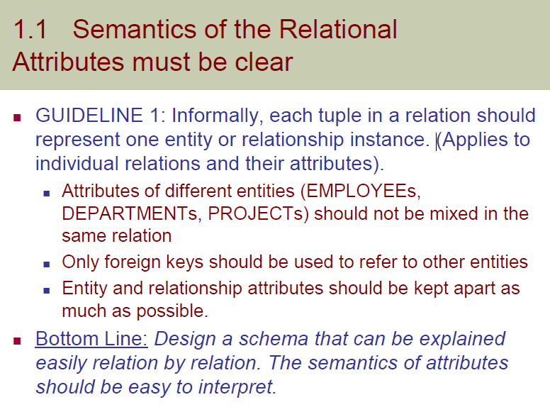

Slide 8
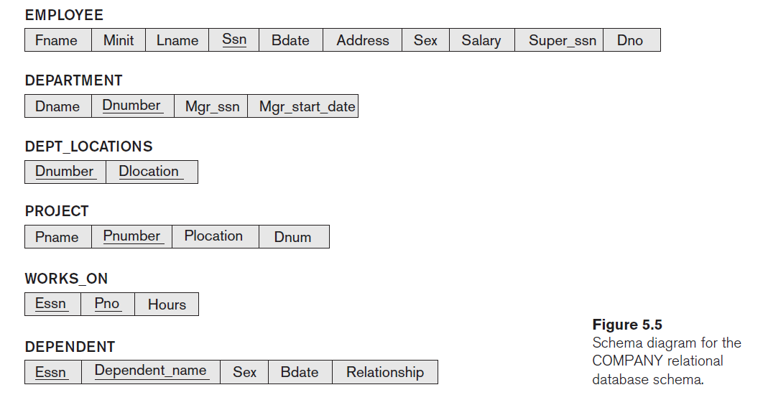
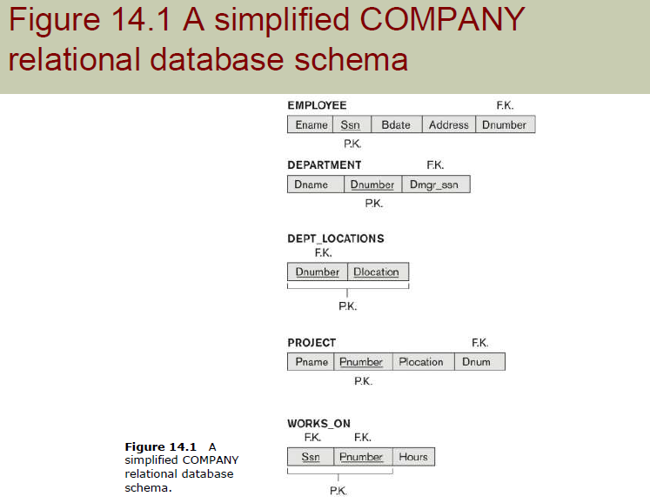

Slide 9
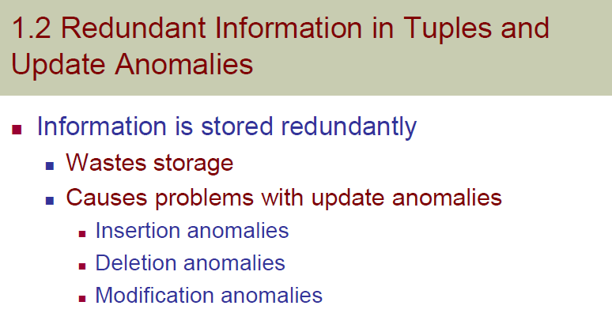

Slide 10
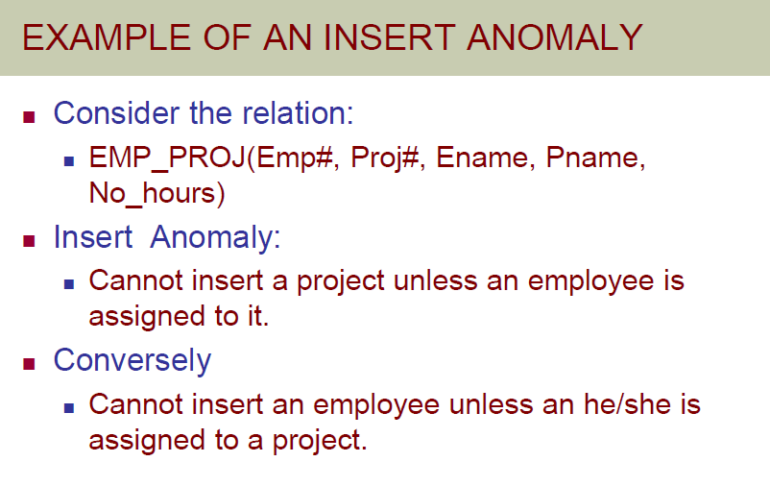

Slide 11
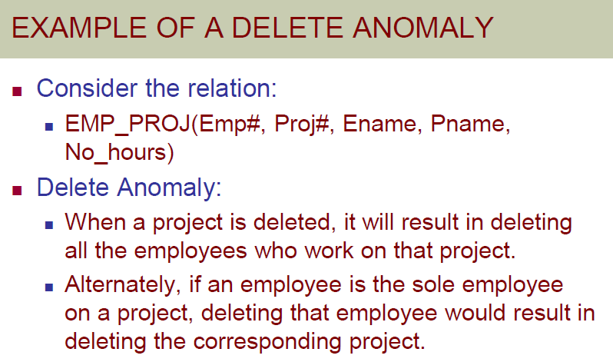

Slide 12
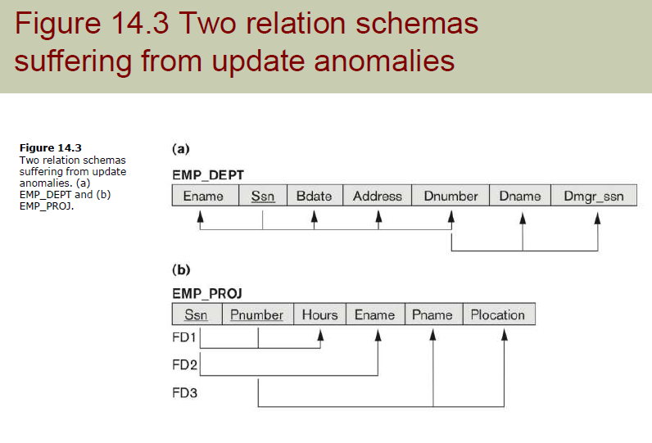

Slide 13
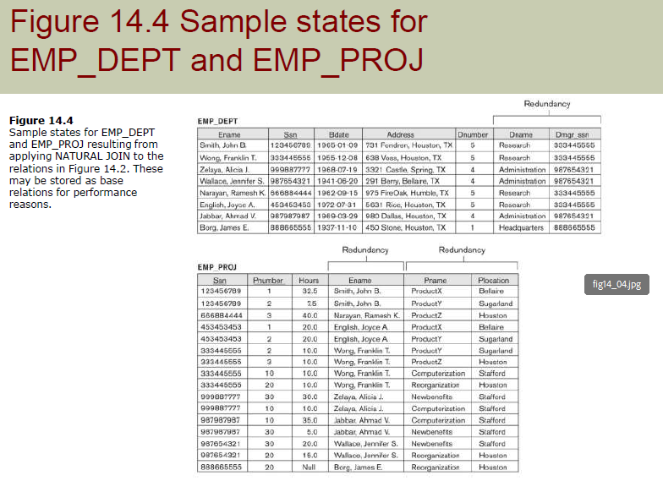

Slide 14
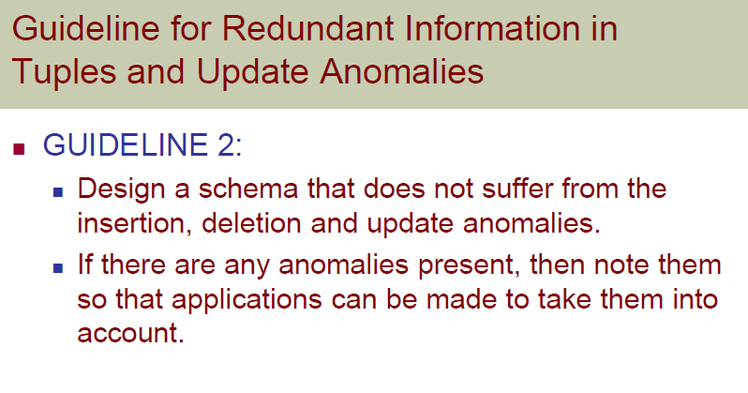

Slide 15
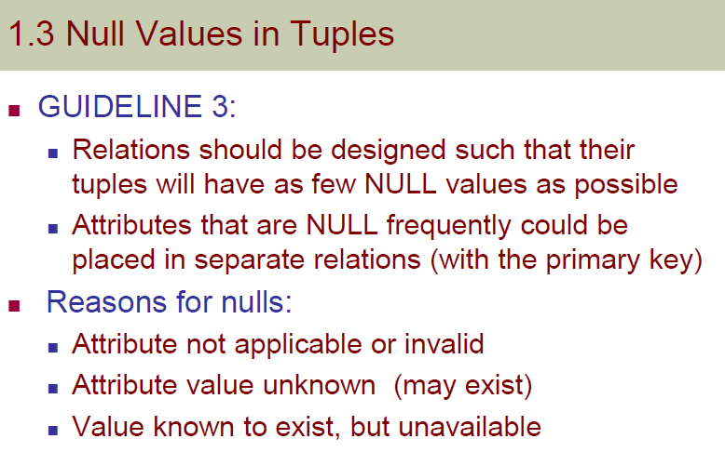

Slide 16
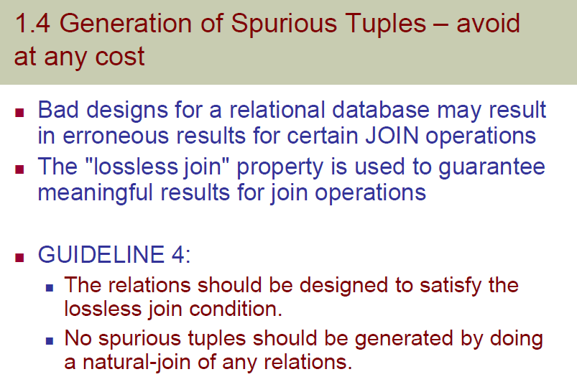
Lossless join NATURAL JOIN/ JOIN in MySQL

Slide 17
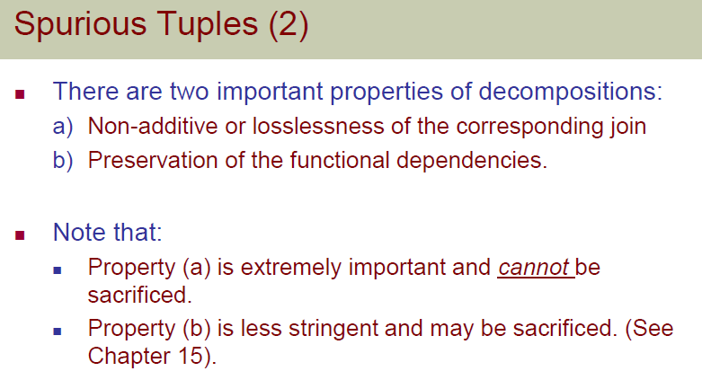
spurious tuples are extraneous or incorrect tuples produced during a join operation, often due to improper join conditions or incorrect table decomposition or fail to preserve the integrity between the tables (i.e. foreign key constraint)
With proper database design and careful handling of joins we can avoid spurious tuples.

Slide 18
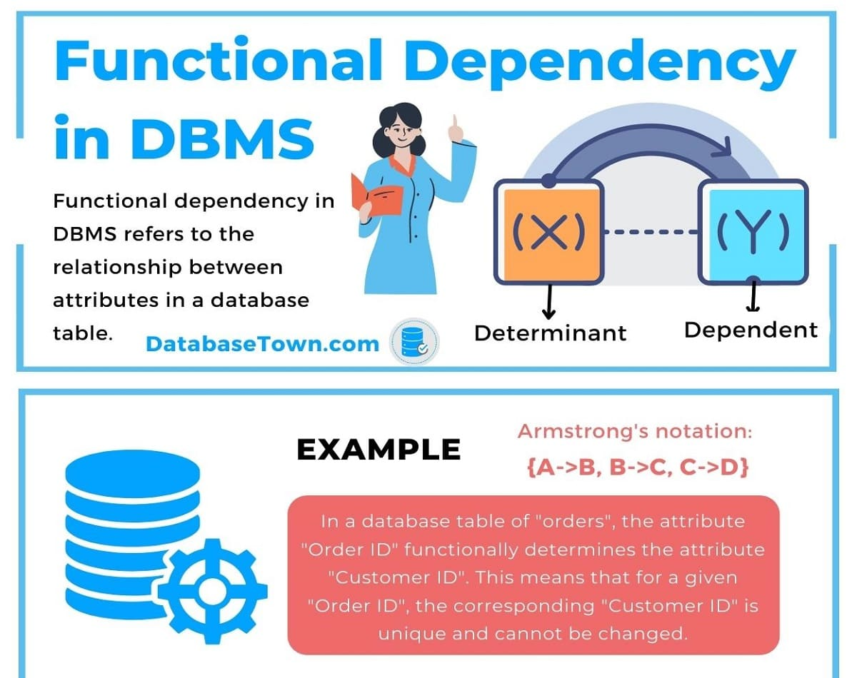
Functional Dependencies
Functional dependencies (FDs) are used to specify formal measures of the "goodness" of relational designs.
FDs and keys are used to define normal forms for relations.
FDs are constraints that are derived from the meaning and interrelationships of the data attributes .

Slide 19
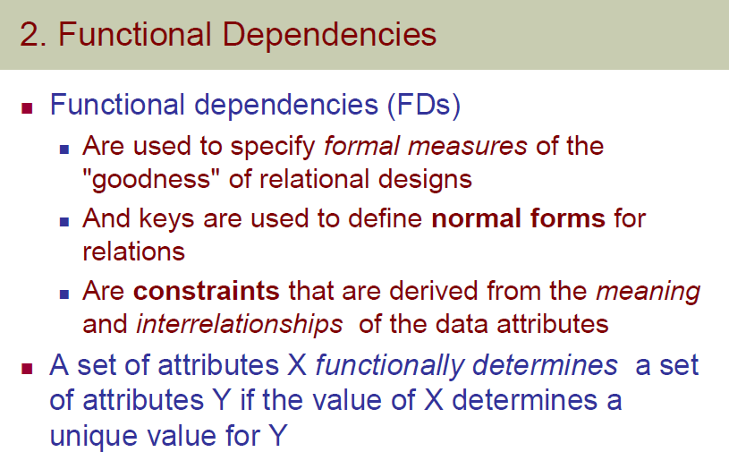

Slide 20
Functional Dependencies (FD)
Mathematical Analogy:
f (a) b
e.gs:. square (4) 16
square root(25) 5
a function b
input
output

Slide 21
Functional Dependencies (FD)
Table (Relation) R
In DBMS,
A B implies that if we know the value of A, we can determine the value of B from the table R, where A and B are the attributes of the relation.
In such cases, we say that A determines B
or
B is determined by A
So, A B is a functional dependency (FD).
In FD, the attribute which is used to determine other attribute is called Determinant and the attribute that is determined using the Determinant is known as Dependant.
No. | Name
1 | Jane
2 | Clara
3 | Cinderella
4 | Haidei
5 | Masha

Slide 22
Functional Dependencies (FD)
What is FD?
A FD is a constraint that specifies the relationship of one attribute to another attribute in a relation.
It’s important to note that functional dependencies only apply to the individual tuples in the table, and not to the table as a whole.
Why FD?
They are used to establish relationships between attributes in a database.
They are used to ensure that the database is in a state of normalization, which helps to identify and minimize data redundancy and improve data integrity by identifying and eliminating data inconsistencies in a database.

Slide 23
Functional Dependencies (FD)
How to denote FD?
A functional dependency is denoted by an arrow “→”.
The functional dependency of A on B is represented by A → B.
Consider a relation with four attributes A, B, C and D,
R (ABCD)
A → BCD
B → CD
For the first functional dependency A → BCD, attributes B, C and D are functionally dependent on attribute A.
Function dependency B → CD has two attributes C and D functionally depending upon attribute B.

Slide 24

Functional Dependencies (FD)
Functional dependency can also be represented diagrammatically like this,
Pointing arrows determines the depending attribute and the origin of the arrow determines the determinant set.

Slide 25
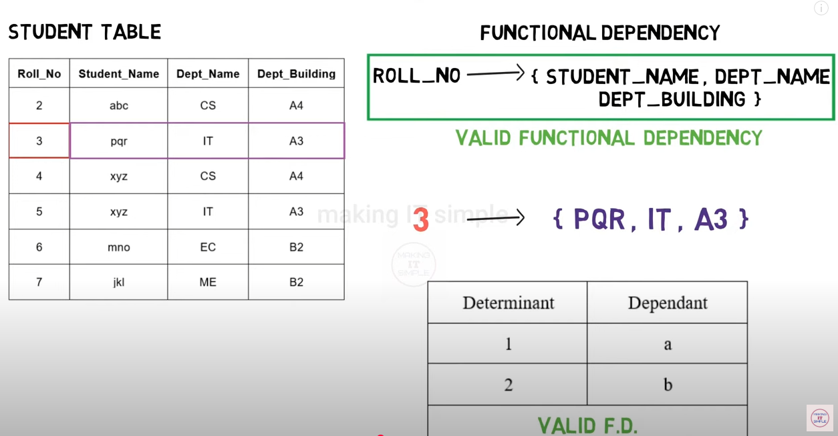
Functional Dependencies (FD)
Valid and Invalid FDs: case (i)

Slide 26
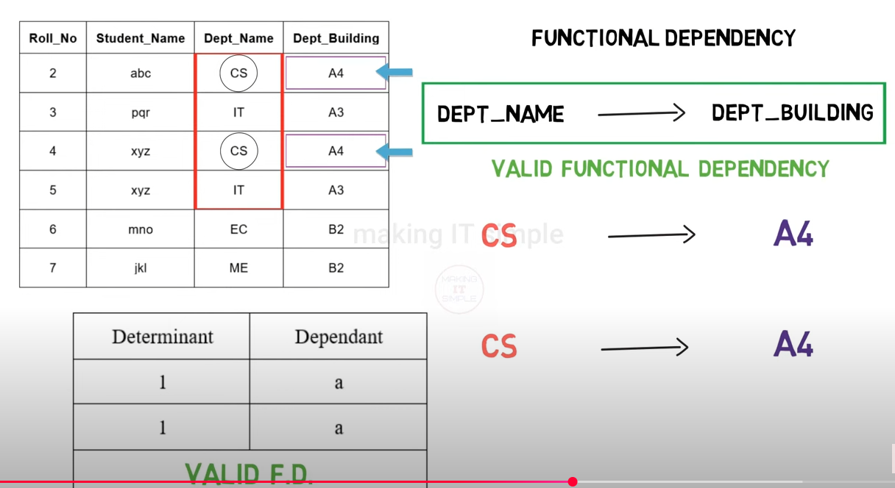
FD: Valid and Invalid FDs: case (ii)

Slide 27
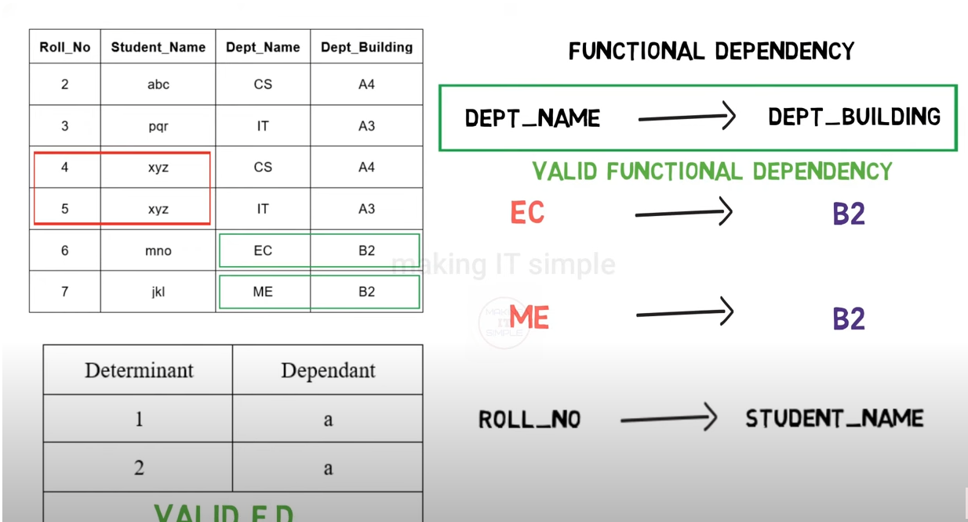
FD: Valid and Invalid FDs: case (iii)
abc
pqr

Slide 28
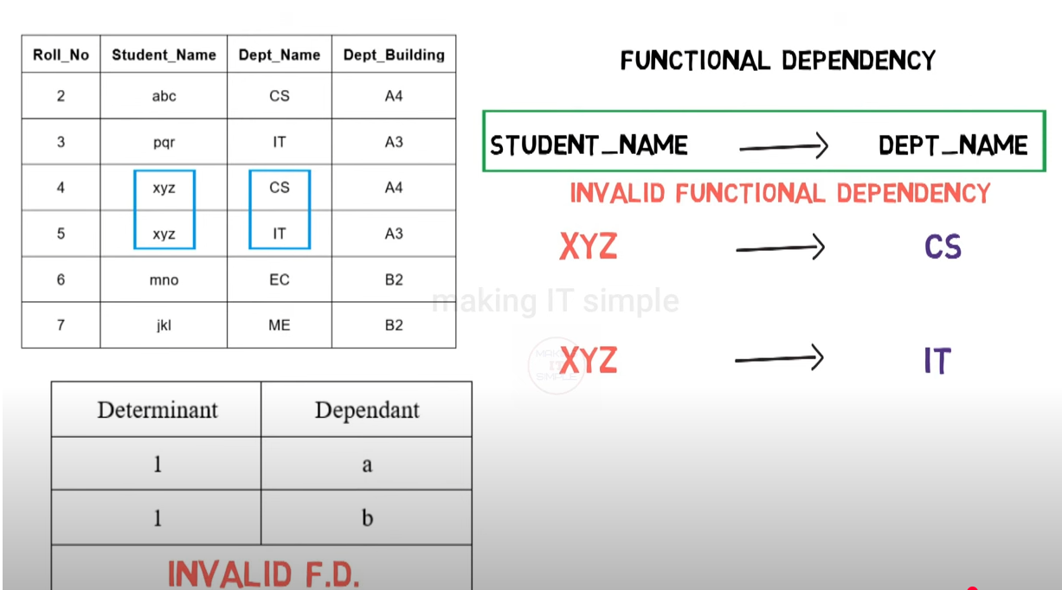
FD: Valid and Invalid FDs: case (iv)

Slide 29
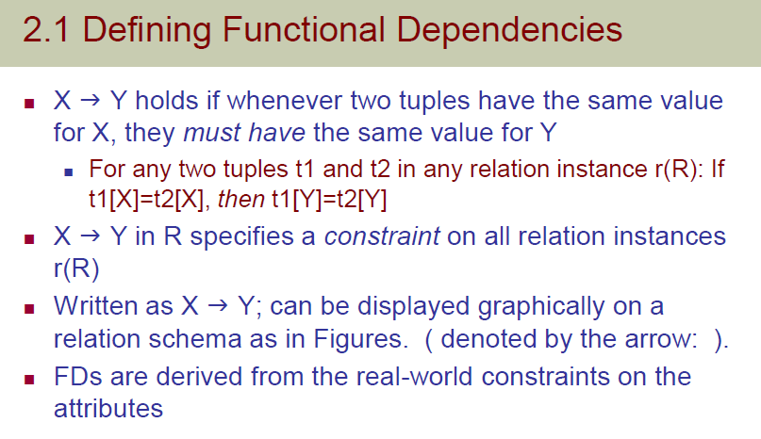
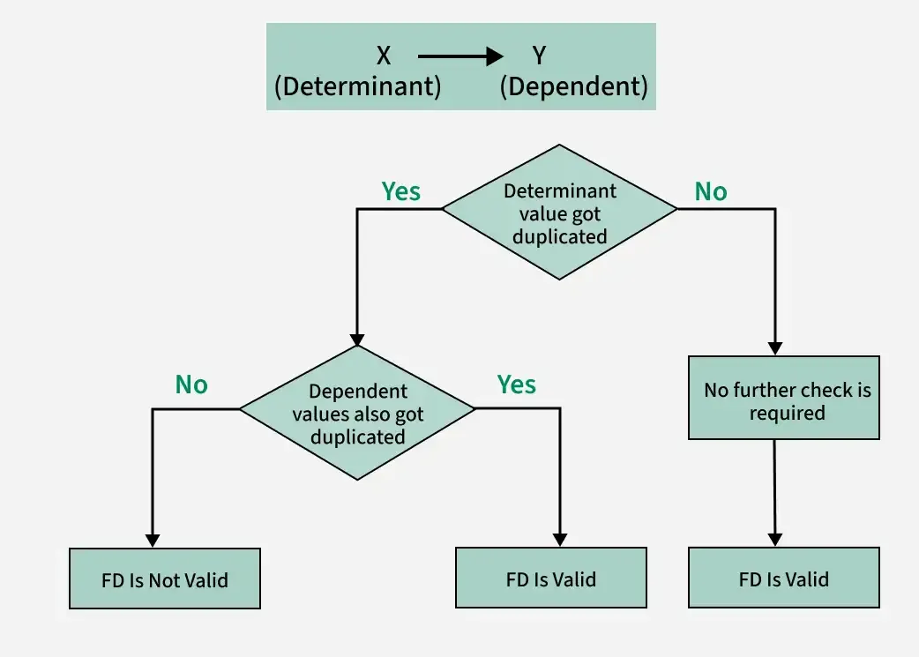

Slide 30
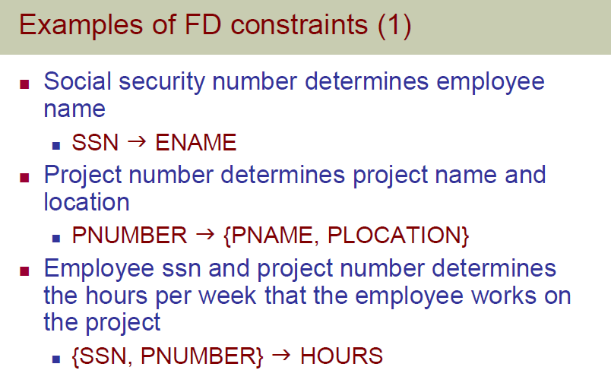

Slide 31
Few more examples of FD

Slide 32
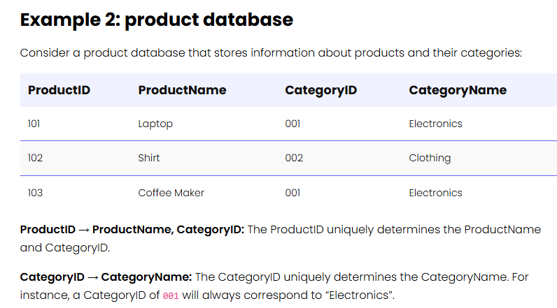
Few more examples of FD

Slide 33
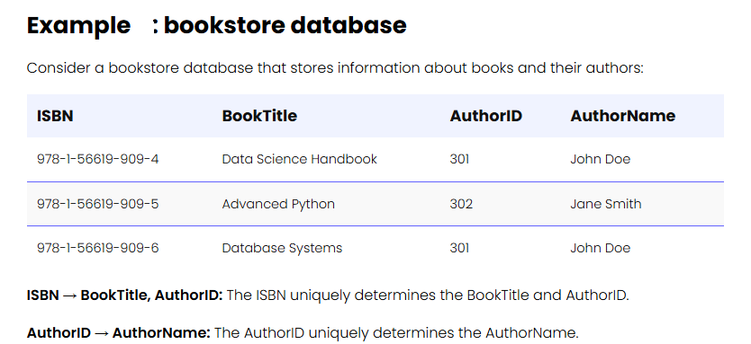
Few more examples of FD

Slide 34
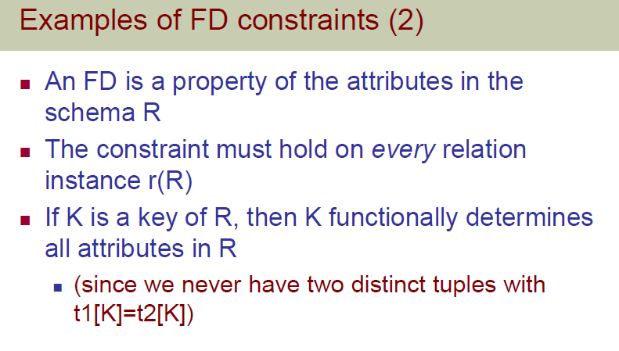

Slide 35
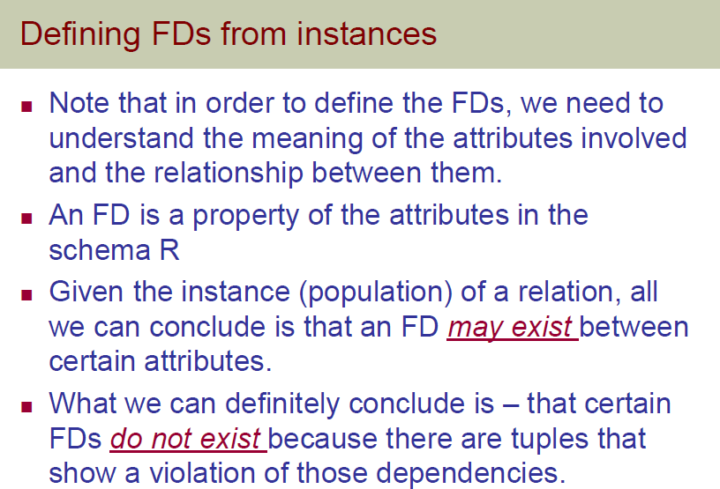

Slide 36
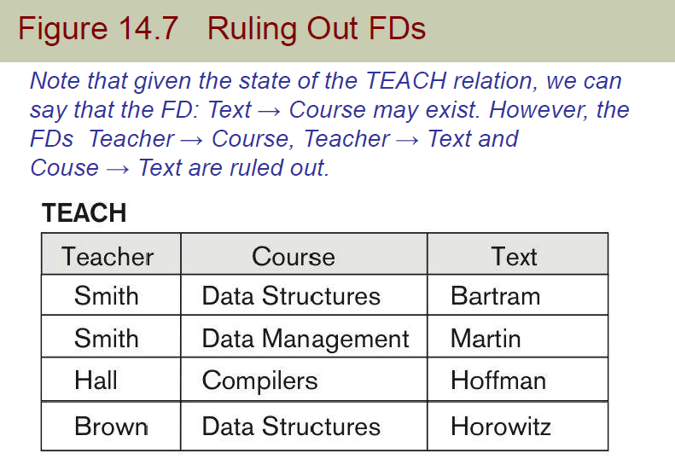

Slide 37
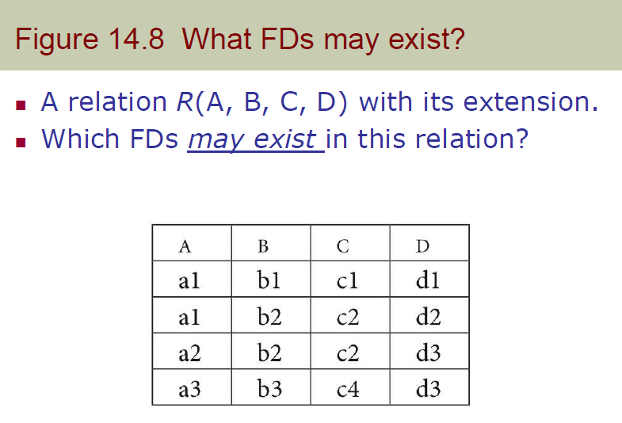

Slide 38
Armstrong’s Axioms/Properties of Functional Dependency in DBMS
William Armstrong in 1974 suggested a few rules related to functional dependency. They are called RAT rules.
Reflexivity: If A is a set of attributes and B is a subset of A, then the functional dependency A → B holds true.
For example, A = {EmployeeID, Name, Department}
B = {EmployeeID, Name} (subset of A)
Then, {EmployeeID, Name, Department} → {EmployeeID, Name}
i.e. {EmployeeID, Name, Department} can uniquely determine the {EmployeeID, Name}.
Also, { Employee_Id, Name } → Name is valid FD as per reflexivity property.

Slide 39
Armstrong’s Axioms/Properties of Functional Dependency in DBMS
Augmentation: If a functional dependency A → B holds true, then appending any number of the attribute to both sides of dependency doesn't affect the dependency. It remains true.
For example, X → Y holds true then, ZX → ZY also holds true.
For example, if { Employee_Id, Name } → { Name } holds true then, { Employee_Id, Name, Age } → { Name, Age }

Slide 40
Armstrong’s Axioms/Properties of Functional Dependency in DBMS
Transitivity: If two functional dependencies X → Y and Y → Z hold true, then
X → Z also holds true by the rule of Transitivity.
For example, if { Employee_Id } → { Name } holds true and
{ Name } → { Department } holds true,
then { Employee_Id } → { Department } also holds true.

Slide 41
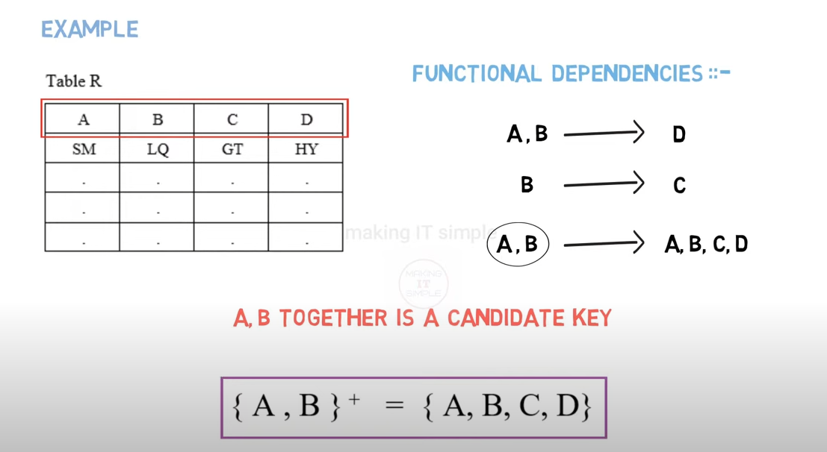
Partial Dependencies in DBMS
AB Closure

Slide 42
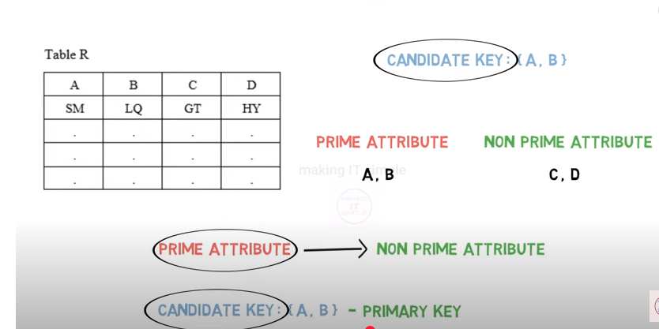
Partial Dependencies in DBMS
Attributes that are part of Candidate key are called as PRIME ATTRIBUTES.
Attributes that are NOT part of Candidate key are called as NON PRIME ATTRIBUTES.

Slide 43
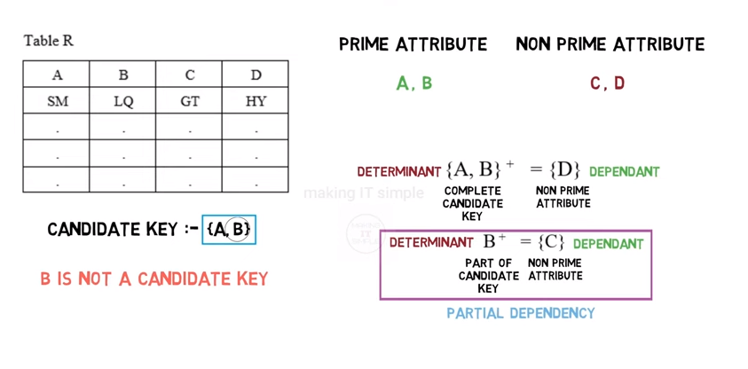
Partial Dependencies in DBMS
Attribute D is determined by A, B
A Non prime attribute C can be determined using part of Candidate key i.e. B, this type of dependency is known as Partial Dependency.

Slide 44
Partial Dependencies in DBMS: Definition
Partial dependency in a relational database occurs when a non-prime attribute (i.e., not part of any candidate key) is functionally dependent on only a part of the primary key, rather than the entire primary key.

Slide 45
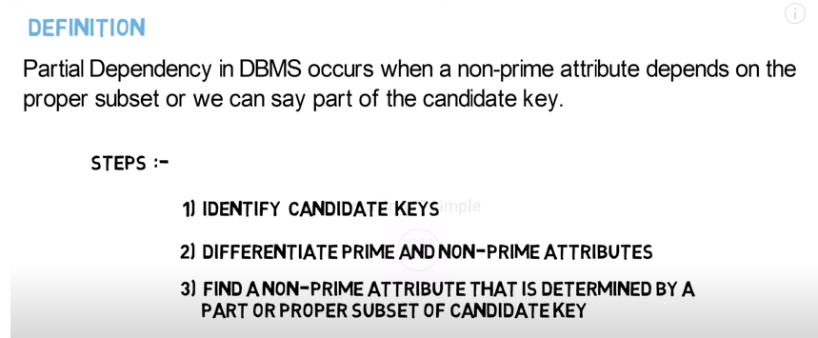
Partial Dependencies in DBMS

Slide 46
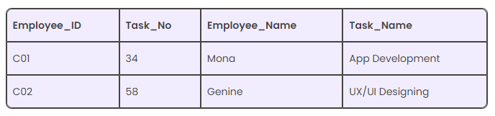
Partial Dependencies in DBMS: Various examples to illustrate when does Partial Dependency occur?
Here, Prime (key) attributes are
Employee_ID and Task_No.
non-prime attributes are
Employee_Name and Task_Name.
Now, Employee_Name can be determined using the Employee_ID and hence there exists a partial dependency.
Also, Task_Name can be determined using the Task_No. It makes the relation Dependent Partially.
Consider Employee_Task Relation
Solution:
We decompose (split) the tables to remove Partial Dependency

Slide 47

Partial Dependencies in DBMS: Various examples to illustrate when does Partial Dependency occur?
2. Consider Course_Enrollment Relation. Can you identify a Partial Dependency if primary key attributes are Student_ID and Course_ID ?

Slide 48
Partial Dependencies in DBMS: Various examples to illustrate when does Partial Dependency occur?
3. Consider a table called "Orders" with the following attributes:
OrderID, CustomerID, OrderDate, ProductID, and Quantity.
The table's primary key is OrderID, and the non-key attributes are CustomerID, OrderDate, ProductID, and Quantity.
Answer the following:
(i) If the value of CustomerID depends only on OrderID, check if there is a Partial Dependency?
(ii) If the combination of OrderID and CustomerID, are prime key attributes, then does there exists a Partial dependency?
(iii) If the combination of OrderID and ProductID, are prime key attributes, then does there exists a Partial dependency?
(iv) If the combination of OrderID , CustomerID and ProductID, are prime key attributes, then does there exists a Partial dependency?

Slide 49
Partial Dependencies in DBMS: Various examples to illustrate when does Partial Dependency occur?
e.g.4:
InvNum
LineNum
Qty
InvDate
Candidate keys: {InvNum, LineNum} InvDate , which is partially dependent on {InvNum, LineNum} as InvNum is a determinant of InvDate and InvNum is part of a candidate key.

Slide 50
Types of Functional Dependencies in DBMS
Trivial functional dependency
Non-Trivial functional dependency
Multivalued functional dependency
Transitive functional dependency

Slide 51
Types of Functional Dependencies in DBMS
Trivial functional dependency
In Trivial Functional Dependency, a dependent is always a subset of the determinant.
i.e. If X → Y and Y is the subset of X, then it is called trivial functional dependency.
X → Y is called a trivial functional dependency if Y is the subset of X.
A trivial functional dependency occurs when an attribute or a set of attributes determines itself or any subset of itself. It means that, the dependency is obvious and doesn’t provide any useful information about the relationship between attributes.

Slide 52

Types of Functional Dependencies in DBMS
Trivial functional dependency
Example 1: A→A , B→B ABC -> AB
ABC -> A
ABC -> ABC
{ Employee_Id, Name } → { Name } is a Trivial functional dependency, since the dependent Name is the subset of determinant
{ Employee_Id, Name }.

Slide 53
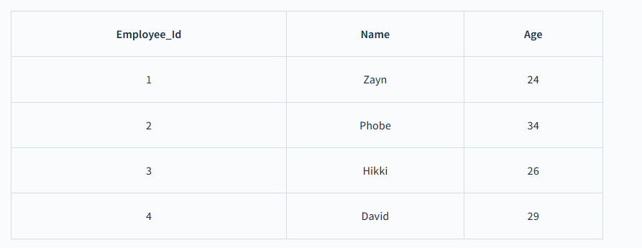
Types of Functional Dependencies in DBMS
Non-Trivial functional dependency
In Non-trivial functional dependency, the dependent is strictly not a subset of the determinant.
i.e. If X → Y and Y is not a subset of X, then it is called Non-trivial functional dependency.
{ Employee_Id } → { Name } is a non-trivial functional dependency because Name (dependent) is not a subset of Employee_Id(determinant).
{ Employee_Id, Name } → { Age } is also a non-trivial functional dependency.

Slide 54
Types of Functional Dependencies in DBMS
Multivalued functional dependency
In Multivalued functional dependency, attributes in the dependent set are not dependent on each other.
For example, X → { Y, Z }, if there exists is no functional dependency between Y and Z, then it is called as Multivalued functional dependency.

Slide 55

Types of Functional Dependencies in DBMS
Multivalued functional dependency
{ Employee_Id } → { Name, Age } is a Multivalued functional dependency, since the dependent attributes Name, Age are not functionally dependent (i.e. Name → Age or Age → Name doesn’t exist

Slide 56
Types of Functional Dependencies in DBMS
Transitive functional dependency
Consider two functional dependencies A → B and B → C then according to the transitivity axiom A → C must also exist. This is called a transitive functional dependency.
i.e. dependent is indirectly dependent on determinant in Transitive functional dependency.

Slide 57
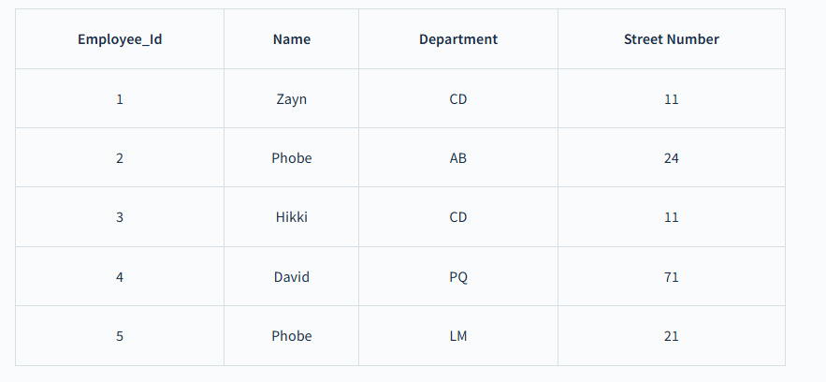
Types of Functional Dependencies in DBMS
Transitive functional dependency
{ Employee_Id → Department } and { Department → Street Number } holds true.
Hence, according to the axiom of transitivity, { Employee_Id → Street Number } is a valid functional dependency.

Slide 58
Trivial Functional Dependencies
A functional dependency is trivial if it is satisfied by all instances of a relation.
Example:
ID, name →ID
name →name
In general, α → β is trivial if β ⊆ α

Slide 59
Takeaway:
The process of Normalization starts with identifying the candidate keys in the relation. Without functional dependency, it's impossible to find candidate keys and normalize the database.

Slide 60
Normal Forms Based on Primary Keys
Normalization of Relations
Practical Use of Normal Forms
Definitions of Keys and Attributes Participating in Keys
First Normal Form
Second Normal Form
Third Normal Form

Slide 61
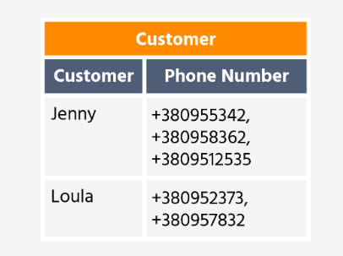


Normal Forms Based on Primary Keys
Unnormalized form (UNF): A table that contains one or more repeating groups. Also known as non-first normal form (NF2).
An Unnormalized Form describes a database that doesn't meet any of the normal form criteria. NoSQL databases (MongoDB, Apache etc.) are based on the principles of the unnormalized relational model.
Repeating group: an attribute or group of attributes within a table that occurs with multiple values for a single occurrence of the nominated key attributes of that table.

Slide 62
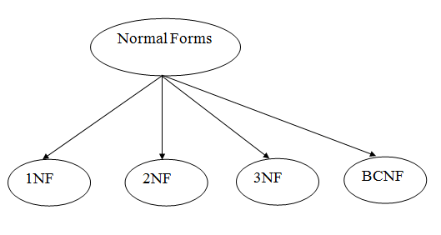
Introduction to Normalization
Normalization is the process of effectively organizing the data in the database.
Normalization is a database design technique that reduces data redundancy from a relation or set of relations and eliminates undesirable characteristics like Insertion, Update and Deletion Anomalies.
Normalization divides the larger table into the smaller tables and links them using relationship.
The purpose of Normalization in SQL is to eliminate redundant (repetitive) data and ensure data is stored logically.
Types of Normal Forms
There are the four types of normal forms

Slide 63
Introduction to Normalization
Normalization: is the process of decomposing unsatisfactory "bad" relations by breaking up their attributes into smaller relations.
Normal form: Condition using keys and FDs of a relation to certify whether a relation schema is in a particular normal form.
2NF, 3NF, BCNF based on keys and FDs of a relation schema
4NF based on keys, multi-valued dependencies
The inventor of the relational model Edgar Codd proposed the theory of normalization of data with the introduction of the First Normal Form, and he continued to extend theory with Second and Third Normal Form. Later he joined Raymond F. Boyce to develop the theory of Boyce-Codd Normal Form.

Slide 64
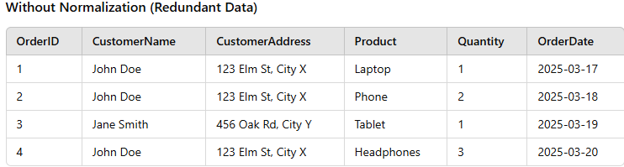
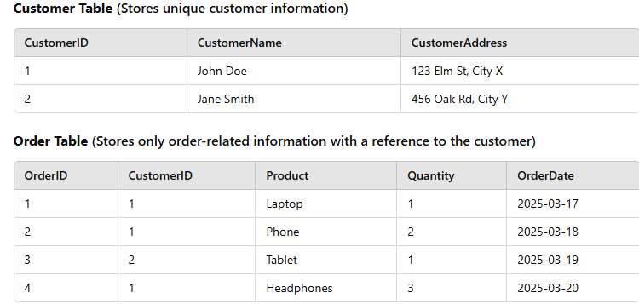
Introduction to Normalization
The purpose of Normalization in SQL is to eliminate redundant (repetitive) data and ensure data is stored logically.
Normalization in relational databases is about logically organizing data to reduce redundancy, ensure consistency, and avoid anomalies (such as update anomalies, delete anomalies). Physically, data is still stored on disk in tables, rows, and columns. The database management system (DBMS) will store the data physically (on disks or in memory) in a way that optimizes access, indexing, and retrieval (using techniques like indexing or partitioning). However, normalization does not dictate how the DBMS stores the data physically.
CustomerID is used as a foreign key in the Order Table, linking each order to a customer.

Slide 65
Normal Form | Description
1NF | A relation is in 1NF if it contains an atomic value.
2NF | A relation will be in 2NF if it is in 1NF and all non-key attributes are fully functional dependent on the primary key.
3NF | A relation will be in 3NF if it is in 2NF and no transition dependency exists.
4NF | A relation will be in 4NF if it is in Boyce Codd normal form and has no multi-valued dependency.
5NF | A relation is in 5NF if it is in 4NF and not contains any join dependency and joining should be lossless.
The Theory of Data Normalization in MySQL server is still being developed further. For example, there are discussions even on 6th Normal Form. However, in most practical applications, normalization achieves its best in 3rd Normal Form.

Slide 66
First Normal Form (1NF)
A Relation will be 1NF if it contains an atomic value (i.e. indivisible or without any group data item) and every relation should possess a unique primary key — the smallest set of columns that distinctly identifies a record.
Disallows composite attributes, multivalued attributes, and nested relations; attributes whose values for an individual tuple are non-atomic.
Considered to be part of the definition of relation.
It states that an attribute of a table cannot hold multiple values. It must hold only single-valued attribute.
i.e. First normal form disallows the multi-valued attribute, composite attribute, and their combinations.

Slide 67


First Normal Form (1NF)
This table is not in 1NF as it contains the multivalued attribute. It can be normalized to the first normal form by distributing the multivalued attributes in different columns as follows.

Slide 68

First Normal Form (1NF)
Lack of unique Primary key
Phone Number attribute holds more than one values.
The Customer ID column in the Phone Numbers table should be designated as a foreign key.

Slide 69
Second Normal Form (2NF)
A Relation is in 2 NF if:
It is in first normal form or 1NF
It doesn’t contain any partial dependencies. i.e. All non-key attributes (i.e., columns not included in the primary key) must be fully dependent on the primary key.

Slide 70
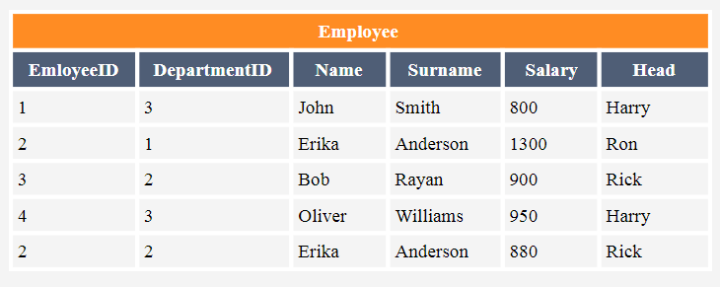
Second Normal Form (2NF)
Employee table with
EmployeeID and DepartmentID as Candidate keys (Primary keys).
Check if Employee table is in 2NF:
Table is in 1 NF as there is a composite Primary key. Also, Table has atomic values.
The non-prime attributes, Name, Surname, and Head are dependent only on part of the composite Primary key. So violates the rule, and hence the table is not in 2NF.
Further, there is a Modification anomaly, if we try to delete DepartmentID row from the table, we can’t determine Head in such case.

Slide 71
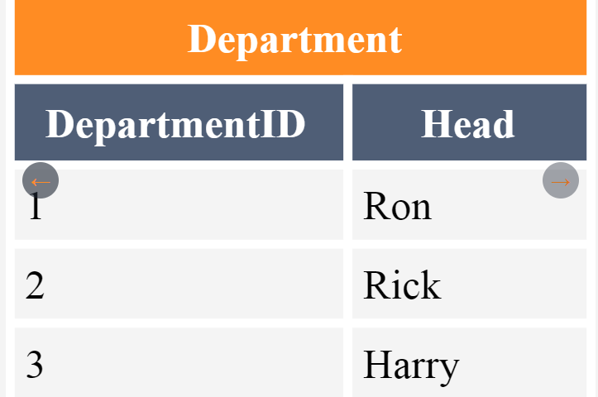
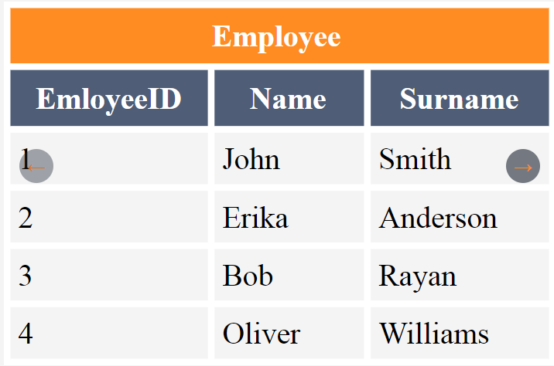
Second Normal Form (2NF)

Slide 72
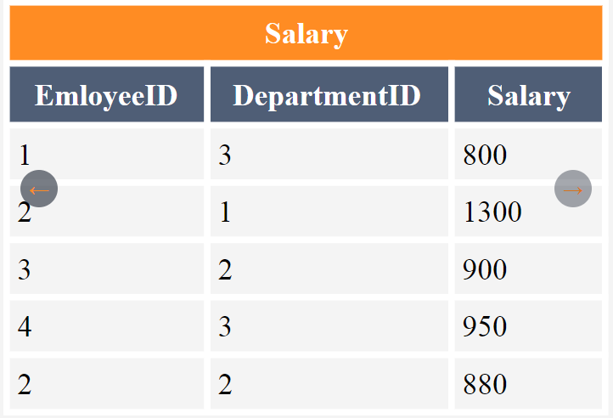
Second Normal Form (2NF)
Now, the table aligns with the second normal form, guaranteeing we retain vital information even if rows from the initial table are deleted.

Slide 73
Second Normal Form (2NF)
A table that is in 2NF (Second Normal Form) can still suffer from anomalies, specifically update anomalies, insert anomalies, and delete anomalies. These issues are typically addressed by further normalizing the table to 3NF (Third Normal Form) or beyond. 2NF doesn’t guarantee to resolve the following issues:
Transitive Dependencies: These occur when a non-key column (i.e. non-prime attribute) is dependent on another non-key column, which is then dependent on the primary key. This is the main issue addressed by 3NF.
Anomalies: Even in 2NF, if there are transitive dependencies, the following anomalies may be faced: update anomalies, insert anomalies, and delete anomalies .

Slide 74

Second Normal Form (2NF)
Example of a Table in 2NF with anomalies. Consider the table STUDENT, stores information about students and the teachers.
Here, the primary key is Stu_Id.
The table is in 2 NF.
However, this table suffers from insertion, deletion and update anomalies.

Slide 75

Second Normal Form (2NF)
Insertion anomaly: Suppose that we want to insert information about a new teacher ‘Mayank’ having Teach_Id = ‘206’ , Teach_Qual = ‘MCA’ who has not yet been allotted any student. This is not possible as Stu_Id will contain a null value.
The table assumes that every record in the table represents a student-teacher relationship (i.e., each student is associated with a teacher).

Slide 76
Second Normal Form (2NF)
Deletion anomaly: Suppose that a student whose Stu_Id = 1768 decides to quit the college, so we would have to delete this tuple from the STUDENT relation. Thus, on deleting this tuple, the information about the teacher would also be deleted.
Updation Anomaly: The second normal form also suffers from updation anomaly.
e.g. If the value of the qualifications of the teacher i.e. Teach_Qual whose Teach_Id = ‘204’ is updated from MCA to Ph.D. , then we would have to update this information every row wherever this appears, which may lead to inconsistencies in the database.
How to overcome the anomalies?
Solution: Normalize the table further into 3NF.

Slide 77

Review
1NF eliminated Composite and Multivalued Attributes
2NF eliminated Partial Dependency
3NF……………..

Slide 78
Third Normal Form (3NF)
A Relation is in 3 NF if:
It is in second normal form or 2NF.
It doesn’t contain transitive functional dependencies (for non-prime attributes).
Transitive dependency means indirect dependency
i.e. X→Y (Y is dependent on X) and
Y→Z
so, X→Z.
3 NF is used to reduce the data duplication. It is also used to achieve the data integrity.

Slide 79
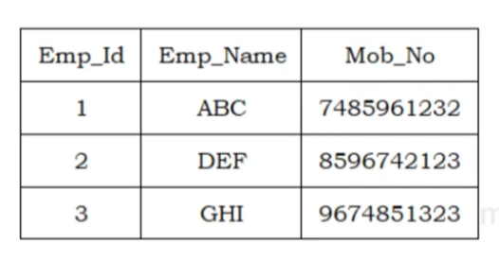
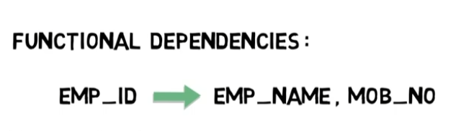
Third Normal Form (3NF)
e.g.:
1st condition:
✓ No Composite and Multivalued Attributes 1NF
✓ No Partial Dependency 2 NF

Slide 80
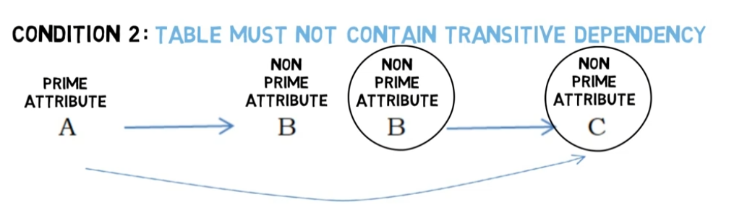
Third Normal Form (3NF)
2nd condition: Table must not contain Transitive Dependency.

Slide 81
Third Normal Form (3NF)
Consider the table BOOK. BookID is the primary key of the table. Check if the table is in 3NF?
BOOK
BookID | CategoryID | Category Type | Price
1 | 1 | History | 300
2 | 2 | Science | 350
3 | 1 | History | 250
4 | 3 | Mystery | 200
5 | 2 | Science | 300
FDs:
BookID CategoryID
CategoryID Category Type
So,
BookID Categorytype
Hence, the table has Transitive Dependency. So, table is not in 3NF.
Further, there is redundancy in the above table, which may be removed with the 3NF.

Slide 82
Third Normal Form (3NF)
How to make the table BOOK to be in 3 NF?
Solution: Decompose the table into multiple tables.
Nonprime attributes, CategoryID and Price are fully functionally dependent on BookID. So, table is in 2NF, i.e. the 1st condition for 3NF is satisfied.
No Transitive FD in this table is found.
Hence, this table BOOK is in 3NF.
Primary key
Nonprime attributes
BOOK1
BookID | CategoryID | Price
1 | 1 | 300
2 | 2 | 350
3 | 1 | 250
4 | 3 | 200
5 | 2 | 300

Slide 83
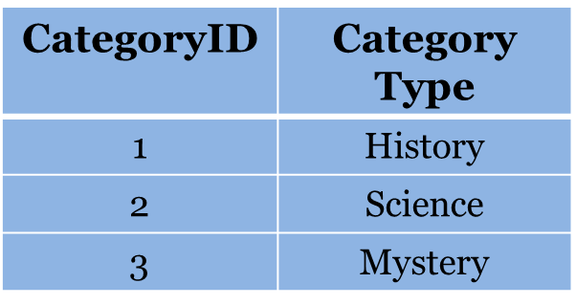
Third Normal Form (3NF)
How to make the table BOOK to be in 3 NF?
Solution: Decompose the table into multiple tables.
Non-prime attribute, CategoryType is fully functionally dependent on CategoryID, which is the primary key. Hence table is in 2NF.
No Transitive FD in this table is found.
Hence, table CATEGORY is in 3NF.
Primary key
Nonprime attribute
CATEGORY
Note that Redundant data has been eliminated in the above table.

Slide 84
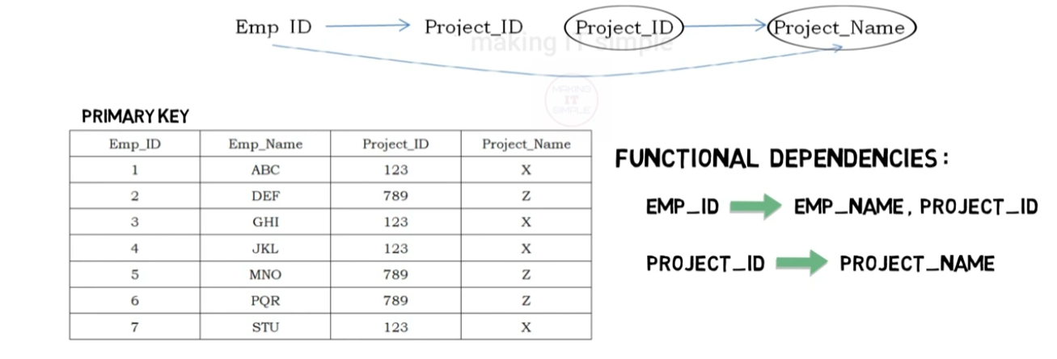
Third Normal Form (3NF)
e.g.2:
Emp ID indirectly determines the Project_Name. A non–prime attribute Project_ID determines another non-prime attribute, Project_Name. So, in this table Transitive Dependency exists and hence the table is not in 3NF.

Slide 85
Third Normal Form (3NF)
How to eliminate Transitive Dependency so that the table exists in 3NF.

Slide 86
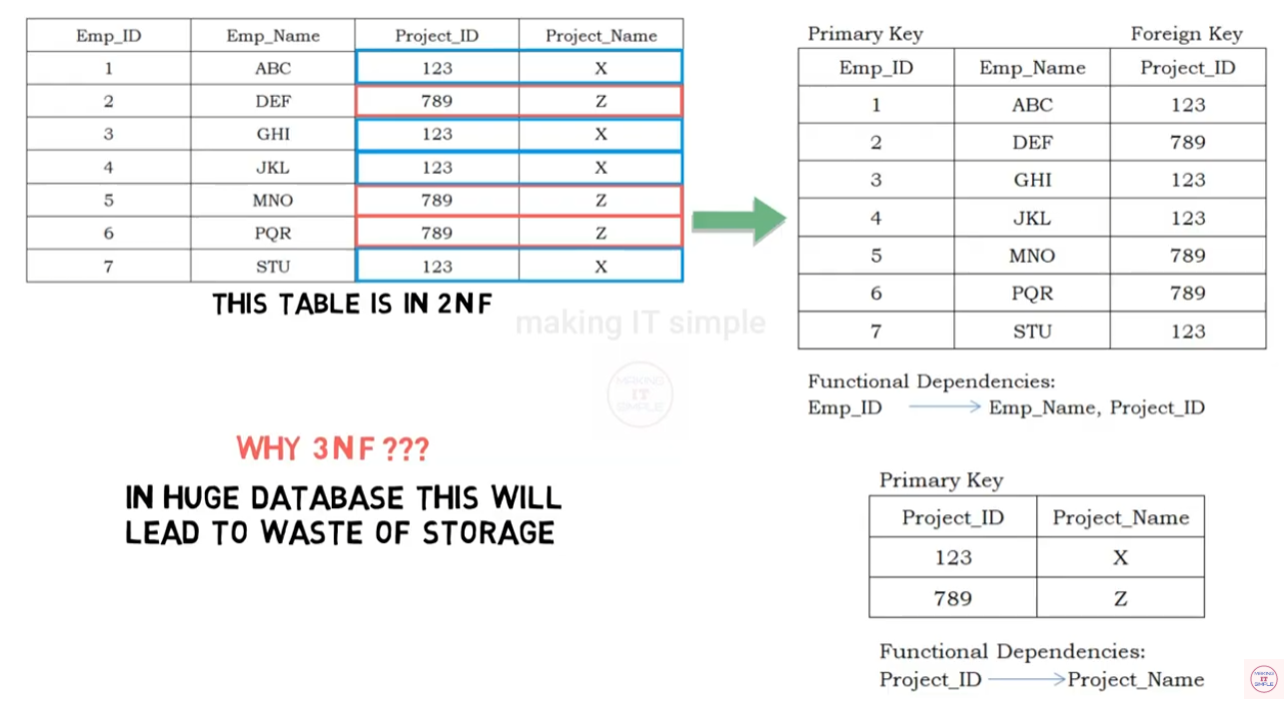
Third Normal Form (3NF)

Slide 87
Boyce-Codd Normal Form (BCNF) or 3.5 NF
BCNF is the advance version of 3NF, hence known as 3.5 NF.
It is stricter than 3NF.
Every relation in BCNF is also in 3NF; however, a relation in 3NF is not necessarily in BCNF.
BCNF Rule: A table is in BCNF if
The table is in 3NF.
Every functional dependency X → Y, X is the super key of the table.

Slide 88
Boyce-Codd Normal Form (BCNF) or 3.5 NF
Super key: a super key is a set of one or more attributes (columns) that can uniquely identify a record (or tuple) in a database table.
A superkey may or may not be minimal, meaning it can have extra attributes that aren't necessary for uniqueness.
superkey cannot have duplicate values in the context of a database table.
A primary key is a candidate key that has been chosen to uniquely identify records in a table. A primary key must be minimal, meaning it cannot have any unnecessary attributes.

Slide 89
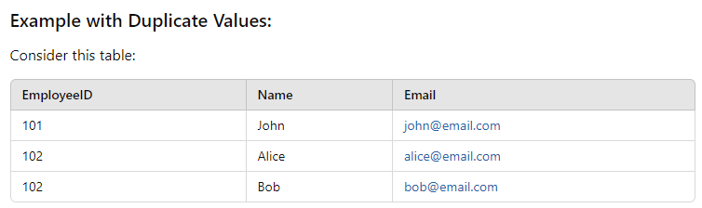
Boyce-Codd Normal Form (BCNF) or 3.5 NF
{EmployeeID} can not be a valid superkey.
Instead, the combination {EmployeeID, Email} would work as a valid superkey because the pair of values will uniquely identify each record.

Slide 90

Boyce-Codd Normal Form (BCNF) or 3.5 NF
e.g. 1:
Super key:

Slide 91


Boyce-Codd Normal Form (BCNF) or 3.5 NF
√
Check if the table is in 1NF.
Check if the table is in 2 NF.
√

Slide 92


Boyce-Codd Normal Form (BCNF) or 3.5 NF
Check if the table is in 3NF.
√

Slide 93

Boyce-Codd Normal Form (BCNF) or 3.5 NF

Slide 94

Boyce-Codd Normal Form (BCNF) or 3.5 NF
Hence, table is not in BCNF or 3.5 NF

Slide 95

Boyce-Codd Normal Form (BCNF) or 3.5 NF
How to make the table to be in BCNF: Decompose the table into 2 tables , R1 and R2 as shown below.

Slide 96
Boyce-Codd Normal Form (BCNF) or 3.5 NF
R1
R2
STUDENT | TEACHER
ABC | MNO
ABC | PQR
XYZ | MNO
XYZ | STU
TEACHER | SUBJECT
MNO | DATABASE
PQR | C
STU | C
R1 and R2 are in BCNF.

Slide 97
Introduction to the higher normal forms
Fourth Normal Form (4NF)
Unlike 2NF, 3NF, BCNF which are concerned with functional dependencies, 4NF is concerned with multi valued dependency (MVD).
A relation will be in 4NF if it is in Boyce Codd normal form (BCNF) and has no multi-valued dependency.
For a dependency A → B, if for a single value of A, multiple values of B exists, then the relation will be a multi-valued dependency.

Slide 98
Introduction to the higher normal forms
MVD (Multi-Valued Dependency) is a concept in database theory related to the relationships between attributes in a relational database. It is an extension of functional dependency and is important when dealing with higher normal forms, specifically Fourth Normal Form (4NF).
Definition of MVD:
A multi-valued dependency (MVD) occurs when one attribute (or a set of attributes) determines a set of other attributes in a way that the values of the determined attributes are independent of the values of other attributes in the relation.
From the definition of multivalued dependency, we can derive the following rule:
• If α →β, then α →→β
That is, every functional dependency is also a multivalued dependency.
MVD is denoted as A →→ B, in which attribute B is determined by a single value of A.

Slide 99


Introduction to the higher normal forms
Note: In DBMS, 1NF (First Normal Form) focuses on eliminating non-atomic values (like storing multiple values in a single cell), while multivalued dependencies (MVDs) address situations where one attribute can have multiple, independent values, which is a concern addressed in higher normal forms like 4NF.
Non-atomic values in 1NF.
Multivalued Dependency.

Slide 100

Introduction to the higher normal forms
Example 1: The concept of MVD or Multivalued dependency refers to having multiple rows in a given table.
There is a car manufacturing company that produces two of the colours in the market, i.e., red and yellow of each of their models, every year.
The columns COLOUR and MANUF_MONTH are dependent on CAR_MODEL, and they are independent of each other. Thus, we can call both of these columns multivalued. These are, as a result, dependent on CAR_MODEL.
The dependencies are:
CAR_MODEL → → MANUF_MONTH
CAR_MODEL → → COLOUR
i.e. “CAR_MODEL multidetermined MANUF_MONTH” and “CAR_MODEL multidetermined COLOUR”.

Slide 101
Introduction to the higher normal forms
Fourth Normal Form (4NF)
Unlike 2NF, 3NF, BCNF which are concerned with functional dependencies, 4NF is concerned with multi valued dependency (MVD).
A relation will be in 4NF if it is in Boyce Codd normal form (BCNF) and has no multi-valued dependency.
For a dependency A → B, if for a single value of A, multiple values of B exists, then the relation will be a multi-valued dependency.

Slide 102
Introduction to the higher normal forms : (4NF)
Course | Instructor | Textbook
DBMS | ABC XYZ PQR | NAVATHE RAGHU
 |  | GREG PETER
OS | MNO
Course→→Instructor
Course→→ Textbook
However, Instructor and Textbook are not related.
MVD exists in this table and hence table can’t be in 4 NF. How to make it to be in 4 NF?
Decompose tables into 2 tables as shown below.
Course | Textbook
DBMS | NAVATHE
DBMS | RAGHU
OS | GREG
OS | PETER
Course | Instructor
DBMS | ABC
DBMS | XYZ
DBMS | PQR
OS | MNO
TEACHER
TEXTBOOK

Slide 103
Introduction to the higher normal forms
Fifth Normal Form (5NF)
A relation is in 5NF if it is in 4NF and not contains any join dependency and joining should be lossless.
5NF is satisfied when all the tables are broken into as many tables as possible in order to avoid redundancy.
5NF is also known as Project-Join Normal Form (PJ/NF).

Slide 104

Introduction to the higher normal forms: 5NF

Slide 105

Introduction to the higher normal forms: 5NF

Slide 106
Introduction to the higher normal forms
Sixth Normal Form (6NF)
A relation is in 6NF, only if, It is in 5NF, and every join dependency on the relation is trivial.
6NF is primarily used to deal with temporal databases, where the database includes information that changes over time, such as historical data.

Slide 107

REVIEW:

Slide 108

REVIEW:

Slide 109
Practice questions
For a database relation R(a,b,c,d), where the domains, a, b,c, d include only atomic values, only the following functional dependencies and those that can be inferred from them hold
a c
b d
This relation is
(i) in first normal form but not in second normal form
(ii) in second normal form but not in first normal form
(iii) in third normal form
(iv) none of the above

Slide 110


Practice questions
2.

Slide 111

3.

Slide 112

4.

Slide 113

5.

Slide 114

6.

Slide 115

7.

Slide 116


8.

Slide 117

9.

Slide 118

Practice questions
10.

Slide 119
THANK YOU

